Slide 1
COMP 304 - Mobile Application Development
Week 1: Introduction to Android platform and Android Application Development

Slide 2
Objectives
Define Android Platform
Discuss the differences between leading mobile operating systems
Examine Android Development Environment and Android Architecture
Write a simple Android application using Android Studio
Summarize Android Application Architecture

Slide 3
What is Android
Android is an open source software stack for a wide range of mobile devices and a corresponding open source project led by Google.
It also includes a rich set of API libraries that make it possible to write applications.
Andy Rubin has been credited as the father of the Android platform.
His company, Android Inc., was acquired by Google in 2005.
Android was announced in 2007.
The first Android mobile handset, the T-Mobile G1, was released in the United States in October 2008.
Android is an open sourceplatform
No need to pay royalties or license fees to develop for the platform.

Slide 4
What is Android
Google hoststhe Android open source project and provides online Android documentation, tools, forums, and the Software Development Kit (SDK) for developers.
All major Android news originates at Google.
The Android ecosystem is made up of a combination of three components:
1. A free, open source operating system for embedded devices
2. An open source development platform for creating applications
3. Devices that run the Android operating system (and the applications created for it)

Slide 5
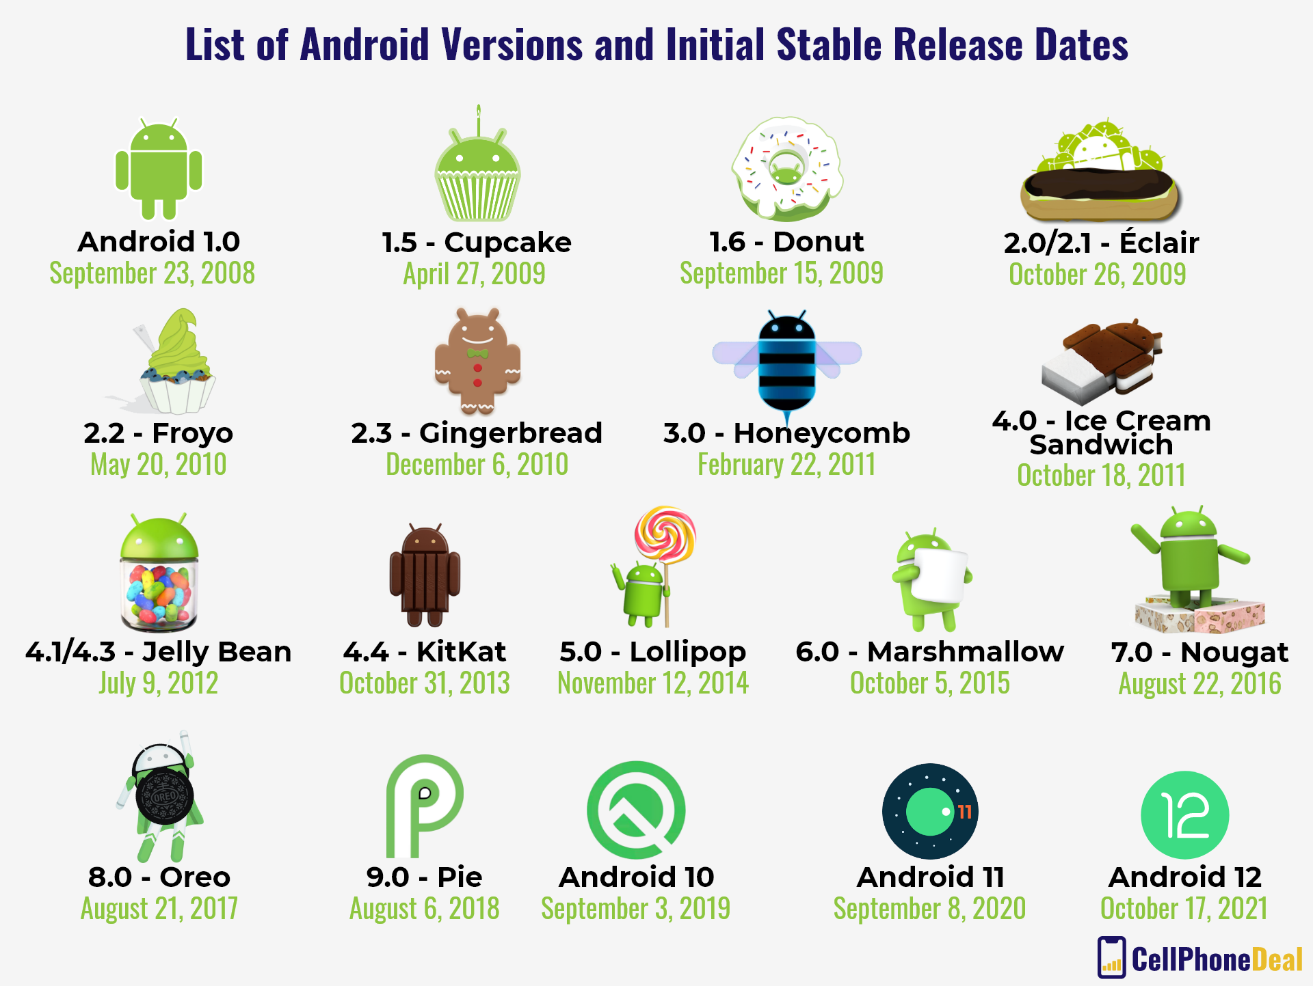
Android Versions

Slide 6
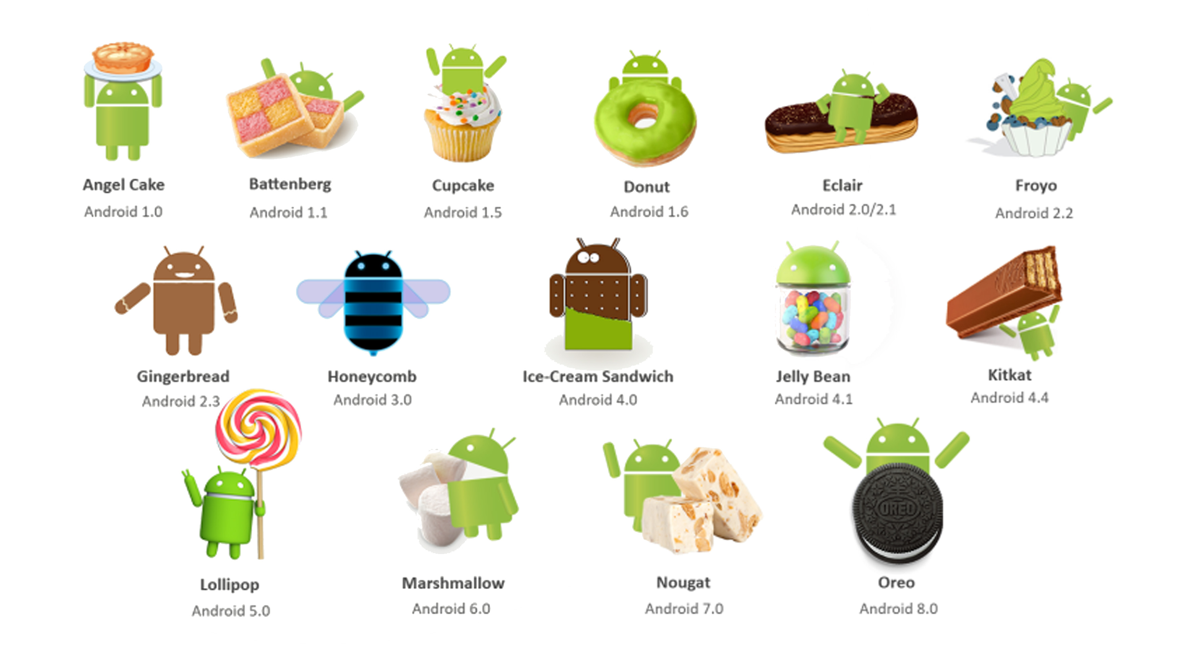
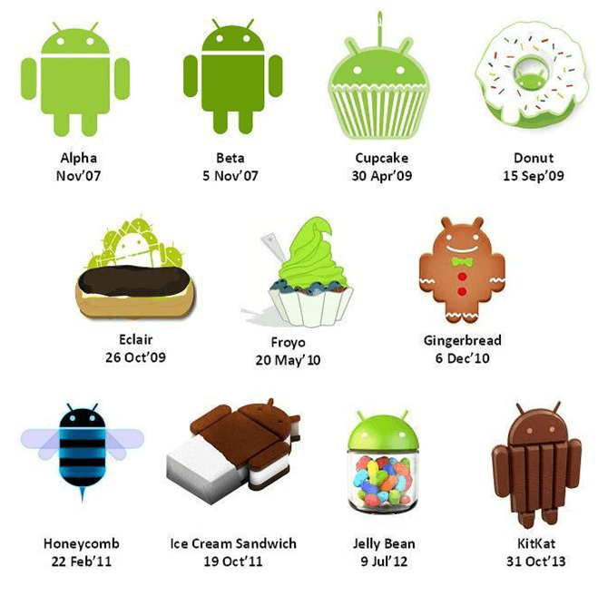
Android Versions

Slide 7
Android Versions
Version | Name
1.0 | Angel cake
1.1 | Battenberg
1.5 | Cupcake
1.6 | Donut
2.0, 2.0.1, 2.1 | Eclair
2.2 – 2.2.3 | Froyo
2.3 – 2.3.2, 2.3.3 – 2.3.7 | Gingerbread
3.0, 3.1, 3.2 – 3.2.6 | Honeycomb

Slide 8
Android Versions
Version | Name
4.0 – 4.0.2, 4.0.3 – 4.0.4 | Ice Cream Sandwich
4.1 – 4.1.2, 4.2 – 4.2.2, 4.3 – 4.3.1 | Jelly Bean
4.4 – 4.4.4, 4.4W – 4.4W.2 | Key Lime Pie
5.0 – 5.0.2, 5.1 – 5.1.1 | Lemon Meringue Pie
6.0 – 6.0.1 | Macadamia Nut Cookie
7.0, 7.1 – 7.1.2 | New York Cheesecake
8.0, 8.1 | Oatmeal Cookie
9 | Pistachio Ice Cream

Slide 9
Android Versions
Version | Name
10 | Quince Tart
11 | Red Velvet Cake
12 | Snow Cone
12.1 | Snow Cone v2
13 | Tiramisu
14 | Upside Down Cake (Latest Version)
15 Beta | Vanilla Ice Cream

Slide 10
Comparisons to competitors
Mobile Operating Systems | Percentage Market Share
Android | 72.11 %
iOS | 27.22 %
Samsung | 0.42 %

Slide 11
Android Platform - Architecture
Android is an open source, Linux-based software stack created for a wide array of devices and form factors. Following figure shows the major components of the Android platform.

Slide 12
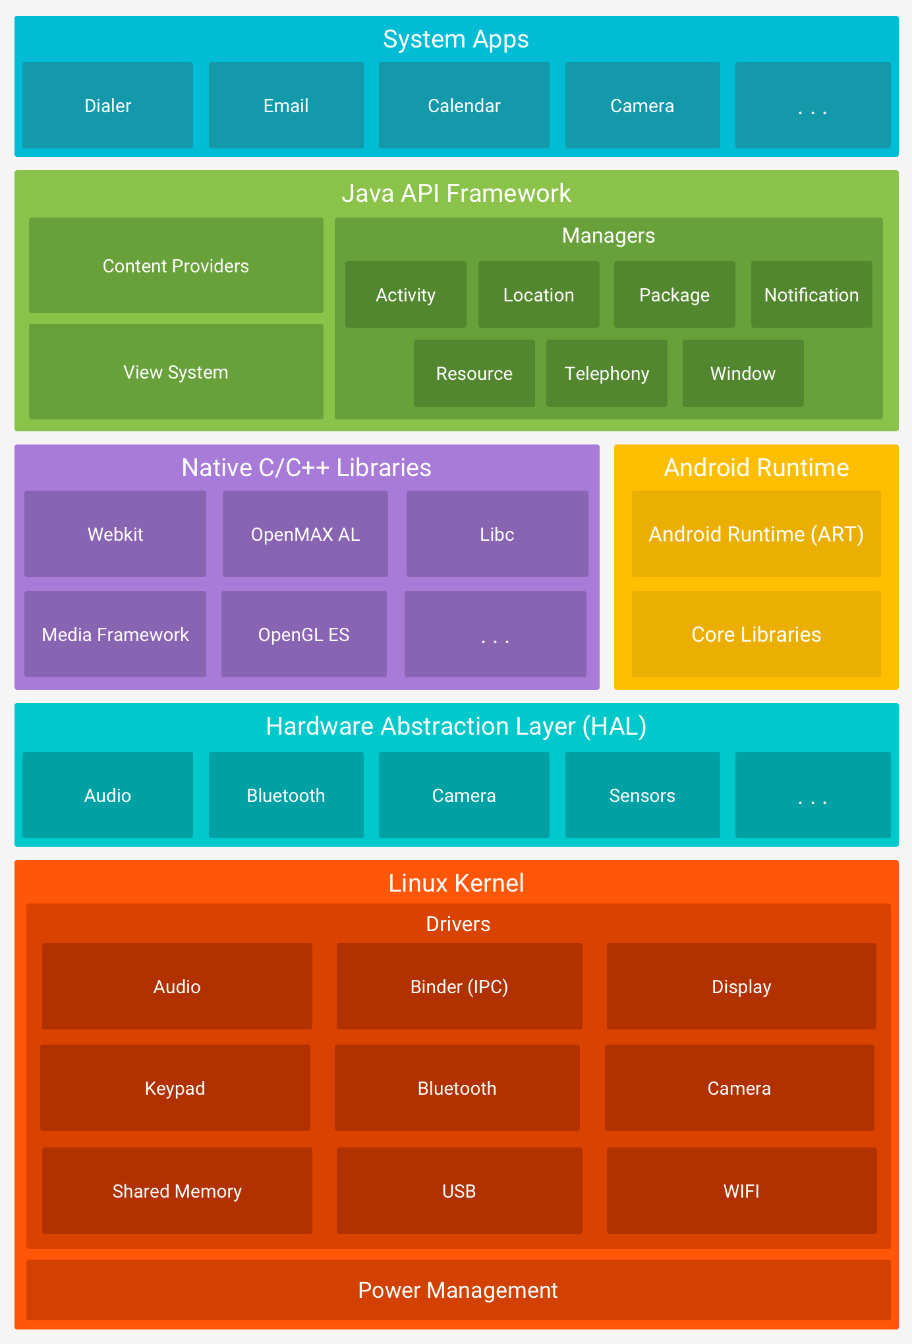

Slide 13
Android Platform Architecture – major components
Linux kernel - it contains all the essential hardware driverslike camera, keypad, display etc.
Android HAL - allows the Android libraries to communicate with the hardware specific device drivers.
Android Native C/C++ Libraries – WebKit, OpenGL, Media, etc.
Android RunTime(ART) –core libraries and runtime environment.
Java API Framework - higher-level services to applications in the form of Java classes.
Applications - your application to be installed on this layer only.

Slide 14
Android and Virtual Machines
VMs are based on computer architectures and provide functionality of a physical computer.
System virtual machines(or full virtualization VMs) provide a substitute for a real machine.
They provide functionality needed to execute entire operating systems.

Slide 15
Android and Virtual Machines
Process virtual machines (like JVM) allow programs to execute in a platform-independent environment.
Implementing the same JVM on multi platforms - applications that it executes can be used on all those platforms.
Android’s Dalvik VM (DVM) was created specifically for mobile device environment.
A (Dalvikexecutable file) DEX file is a translated from bytecodes specially for Android and is optimized for minimal memory footprint.

Slide 16
Android and Virtual Machines

Slide 17
Android Runtime
ART replaced Dalvik starting with Android 5 (Lollipop).
ART runs multiple virtual machines on low-memory
devices by executing (Dalvik executable files) DEX files.
.dex executables are created by transforming Java or Kotlin language compiled classes using SDK tools.
Some of the major features of ART include the following:
Ahead-of-time(AOT) and just-in-time(JIT) compilation
Optimized garbage collection (GC)
Better debugging support

Slide 18
Android Runtime

Slide 19
JIT versus AOT
DalvikJust In Time (JIT) compiler, every time that the app is running:
Dynamically translates a portion of the Dalvik bytecode into machine code and caches it
uses less physical space on the device.
Then it takes the next portion and so on
ART Ahead Of Time (AOT) compiler, when the app is installed on the device:
Statically translates the DEX bytecode into machine codeand stores in the device’s storage.
the code executes much faster
less battery drain because uses native execution, uses CPU less than JIT
The JIT compiler complements AOT compiler, saves storage space, and speeds application and system updates.

Slide 20
Apple’s iOS vs Android
The iOSis the operating system created by Apple Inc. for mobile devices.
The basic functions in iOS and Android are the same.
iOS is a closed system whereas Android is more open.
Users have barely any system permissions in iOS but in Android, users can customize their phones easily.
Android software is available for many manufacturers such as Samsung, LG etc. and this may lead to some quality problems in the cheaper phones.

Slide 21
Application Fundamentals
Android apps can be written using Java, Kotlin, and C++languages –Kotlin is the official language.
The Android SDK tools compile your code along with any data and resource files into an APK, an Android package, which is an archive file with an .apk suffix.
One APK file contains all the contents of an Android app and is the file that Android-powered devices use to install the app.
By default, every app runs in its own Linux process.
Each process has its own virtual machine (VM), so an app's code runs in isolation from other apps.

Slide 22
Development Environment
You need Android SDK and a Java Development Kit (JDK).
Android Studiois the official Android IDE, based onIntelliJ IDEA.
Install the latest Android Studio from this link : https://developer.android.com/studio

Slide 23
Android Development Environment

Slide 24
Development Environment
You also need a system image :

Slide 25
Android Emulator
The Android emulator, is one of the most
important tools provided with the Android SDK.
You will use this tool frequently when designing
and developing Android applications.
The emulator runs on your computer and
behaves much as a mobile device would.
You can load Android applications into the
emulator, test, and debug them.

Slide 26
Device Manager
The Device Manager is a tool you can use to create
and manage Android virtual devices (AVDs),
which define device configurations for the
Android Emulator.
To launch the Device Manager:
In Android Studio, select Tools ->
Device Manager,
or click the Device Manager
icon in the toolbar.

Slide 27

Device Manager

Slide 28
Device Manager
You can create as many AVDs as you would like to use with the Android Emulator.
To effectively test your app, you should create an AVD that models each device type for which you have designed your app to support.
For instance, you should create an AVD for each API level equal to and higher than the minimum version you've specified in your manifest <uses-sdk>tag.
To create an AVD based on an existing device definition:
From the main screen (figure in previous slide), click Create Virtual Device.
In the Select Hardware window, select a device configuration, such as Pixel 4, then click Next.

Slide 29
Select Hardware Window

Slide 30
Android Studio Project Structure

Slide 31
Developing Android Applications
// Kotlin class
classMainActivity: AppCompatActivity() {
//
privatelateinitvar trueButton: Button
privatelateinitvarfalseButton: Button
overridefunonCreate(savedInstanceState: Bundle?) {
super.onCreate(savedInstanceState)
setContentView(R.layout.activity_main)
//
}
}

Slide 32
Developing Android Applications
Notice that the class is based on the Activity class.
An Activity is a single application entity that is used to perform actions.
An application may have many separate activities, but the user interacts with them one at a time.
The onCreate() method will be called by the Android system when your Activity starts —it is where you should perform all initialization and UI setup.
An activity is not required to have a user interface, but usually will.

Slide 33
Developing Android Applications - Running the application

Slide 34
Developing Android Applications
Construct the UI:
package com.example.geoquiz
//
importandroidx.appcompat.app.AppCompatActivity
importandroid.os.Bundle
importandroid.view.View
importandroid.widget.Button
importandroid.widget.Toast
classMainActivity: AppCompatActivity() {
//
private lateinitvar trueButton: Button
private lateinitvar falseButton: Button

Slide 35
Developing Android Applications
override funonCreate(savedInstanceState: Bundle?) {
super.onCreate(savedInstanceState)
setContentView(R.layout.activity_main)
//
trueButton= findViewById(R.id.true_button)
falseButton= findViewById(R.id.false_button)
//
trueButton.setOnClickListener{ view: View ->
// Do something in response to the click here
Toast.makeText(
this,
R.string.correct_toast,
Toast.LENGTH_SHORT
).show()
}

Slide 36
Developing Android Applications
//
falseButton.setOnClickListener{ view: View ->
// Do something in response to the click here
Toast.makeText(
this,
R.string.incorrect_toast,
Toast.LENGTH_SHORT
).show()
}
}
}

Slide 37
Developing Android Applications
An Android user interface is composed of hierarchies of objects called Views.
A View is a drawable object used as an element in your UI layout, such as a button, image, or (in this case) a text label and two buttons.
Each of these objects is a subclass of the View class and the subclass that handles text is TextView.

Slide 38
Developing Android Applications
Running or debugging your application does the following behind the scenes:
Compiles the current project source to bytecode, and converts that to an Android executable (.dex)
Packages the executable and your project’s resources and manifest into an Android package (.apk)
Starts the virtual device(if you’ve targeted one and it’s not already running)
Deploys your APK to the target device and installs it
Starts your application

Slide 39
Application Architecture
An Android application consists of one or more of the following classifications:
Activities and Fragments - An activity represents a single screen with a user interface..
When a user selects an application from the home screen or application launcher, an activity is started.
Views - Used to construct the user interface controls within your Activities and Fragments.
Services - A service is a component that runs in the background to perform long-running operations or to perform work for remote processes.

Slide 40
Application Architecture
Content providers - A content provider manages a shared set of app data, lets your applications share data.
Broadcast receivers - A broadcast receiver is a component that responds to system-wide broadcast announcements.
Many broadcasts originate from the system -for example, a broadcast announcing that the screen has turned off, the battery is low, or a picture was captured.
Apps can also initiate broadcasts.
Notifications - a consistent and nonintrusive mechanism for signaling your users.
Resources – strings, graphics, etc.
Intents - a mechanism for transferring data between applications and their components

Slide 41
Application Configuration
An Android application, along with a file called AndroidManifest.xml, is deployed to a device.
AndroidManifest.xml contains the necessary configuration information to properly install it to the device.
It includes the required class names and types of events the application is able to process, and the required permissions the application needs to run.
For example, if an application requires access to the network to download a file, for example —this permission must be explicitly stated in the manifest file.
Many applications may have this specific permission enabled.
Such declarative security helps reduce the likelihood that a rogue application can cause damage on your device.

Slide 42
References
Textbook
Android Documentation
https://developer.android.com/guide/components/fundamentals.html
http://developer.android.com/tools/studio/index.html
https://developer.android.com/training/basics/firstapp/creating-project.html
Google Tutorial:
https://developer.android.com/training/basics/firstapp/creating-project.html
https://www.javaworld.com/article/3272244/what-is-the-jvmintroducing-the-java-virtual-machine.html
https://www.javaworld.com/article/3304858/what-is-the-jreintroduction-to-the-java-runtime-environment.html

